Slide 1

What Is Recovery?
Let’s really change the conversation about addiction and recovery

Slide 2

This is a call for the recovery movement and the harm reduction movement to join together and celebrate all forms of recovery whether they involve abstinence or not

Slide 3
Traditional Definition of Recovery
One must be abstinent from all addictive, mood-altering substances except for nicotine and caffeine
One must be working a “spiritual” program and it must involve 12 steps
Everyone else is a dry drunk or dirty alcoholic addict

Slide 4
What’s Wrong With the Traditional Definition
23.5 million Americans are in recovery from an addiction, only about 1.5 million (about 6%) are in a 12 step program (OASAS/drugfree.org)
About half of people who recover from alcohol addiction cut back instead of quit
Some “hard” drug users also recover via moderation
Most non-medical drug use is recreational and does not develop into dependence

Slide 5
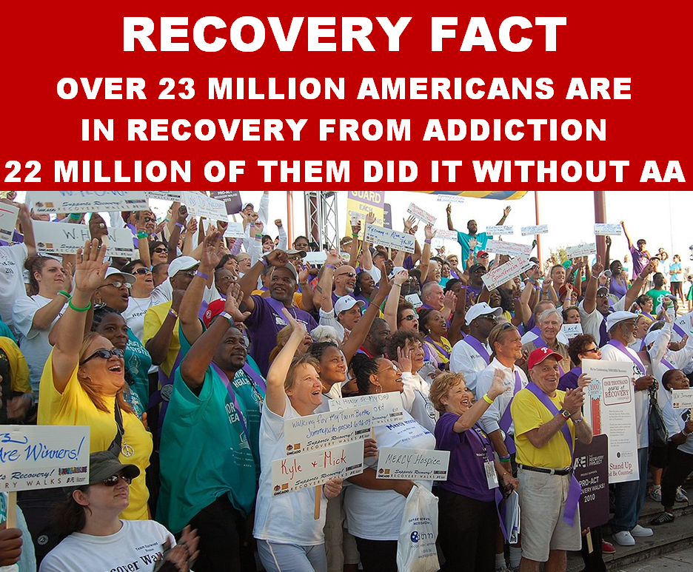

Slide 6
This Was the OASAS Survey Question
“Did you once have a problem with drugs or alcohol, but no longer do?”
10% of those surveyed answered yes which extrapolates to 23.5 million Americans
http://www.oasas.ny.gov/pio/press/20120306Recovery.cfm

Slide 7
NIDA vs. the DSM
NIDA in their promotional materials defines any non medical use of prescription drugs as “drug abuse” (National Institute on Drug Abuse. Prescription drugs: abuse and addiction)
The DSM says there is only drug abuse or dependence if there is impairment
The vast majority who are defined as drug abusers by NIDA’s definition are considered non-abusers by the psychiatric community
Notes:
National Institute on Drug Abuse. Prescription drugs: abuse and addiction. Research Report Series. Bethesda (MD): NIDA; 2011
http://www.drugabuse.gov/sites/default/files/rrprescription.pdf

Slide 8

Drug Users Are Not Dirty
Don’t say “clean” to mean “abstinent”

Slide 9
Typology of Drug Users
Experimenters – try a substance a few times then quit
Recreational Users – use for fun
Dependent Users – have some form of withdrawal or craving if they quit
Non-Dependent Users – have no withdrawal or craving if they quit
Daily Users
Non-Daily Users
Problematic/Chaotic Users aka Abusers
People can fall into MULTIPLE categories

Slide 10
Experimental and Recreational Drug Use and Dependence
Experimental drug use normally does NOT progress to recreational use or dependence
How often recreational use leads to dependence depends on the drug and environmental factors
Even when drug dependence occurs the normal outcome is remission without treatment
Recreational drug users do not have a “disease”
The stance that any non-medical use is misuse/abuse is bullshit

Slide 11
Alcohol US (estimate)
Notes:
Alcohol Facts and Statistics
http://www.niaaa.nih.gov/alcohol-health/overview-alcohol-consumption/alcohol-facts-and-statistics

Slide 12
Tobacco US 1990s (estimate)

Slide 13
Tobacco US Today (estimate)

Slide 14
Culture not just drug determines rates of dependency
Notes:
World Health Organization. (2014). Global status report on alcohol and health-2014. World Health Organization.
http://www.who.int/substance_abuse/publications/global_alcohol_report/en/

Slide 15
DSM 5 Criteria for SUD
A) A problematic pattern of substance use leading to clinically significant impairment or distress, as manifested by at least two of the following, occurring within a 12-month period:

Slide 16
1. Substance is often taken in larger amounts or over a longer period than was intended.
2. There is a persistent desire or unsuccessful efforts to cut down or control substance use.
3. A great deal of time is spent in activities necessary to obtain substance, use substance, or recover from its effects.
4. Craving, or a strong desire or urge to use substance.
5. Recurrent substance use resulting in a failure to fulfill major role obligations at work, school, or home.
6. Continued substance use despite having persistent or recurrent social or interpersonal problems caused or exacerbated by the effects of substance.

Slide 17
7. Important social, occupational, or recreational activities are given up or reduced because of substance use.
8. Recurrent substance use in situations in which it is physically hazardous.
9. Substance use is continued despite knowledge of having a persistent or recurrent physical or psychological problem that is likely to have been caused or exacerbated by substance.
10. Tolerance, as defined by either of the following:
a. A need for markedly increased amounts of substance to achieve intoxication or desired effect.
b. A markedly diminished effect with continued use of the same amount of substance.
11. Withdrawal, as manifested by either of the following:
a. The characteristic withdrawal syndrome for substance
b. Substance (or a closely related substance) is taken to relieve or avoid withdrawal symptoms.

Slide 18
Legal involvement removed as criterion
Severity
  Mild: two to three symptoms
  Moderate: four to five
  Severe: six or more
Course Specifiers:
  “in early remission”
  “in sustained remission”
  “on maintenance therapy”
  “in a controlled environment”

Slide 19
What Is Recovery?
We say it is NO IMPAIRMENT, NO DISTRESS, NO PROBLEMS
This can mean abstinence or non-problematic use
Abstinence or a spiritual program are NOT requirements for being in recovery
Reduction in impairment is partial recovery
Self recovery without AA and without treatment is the norm for all addictions – people overcome them on their own power

Slide 20
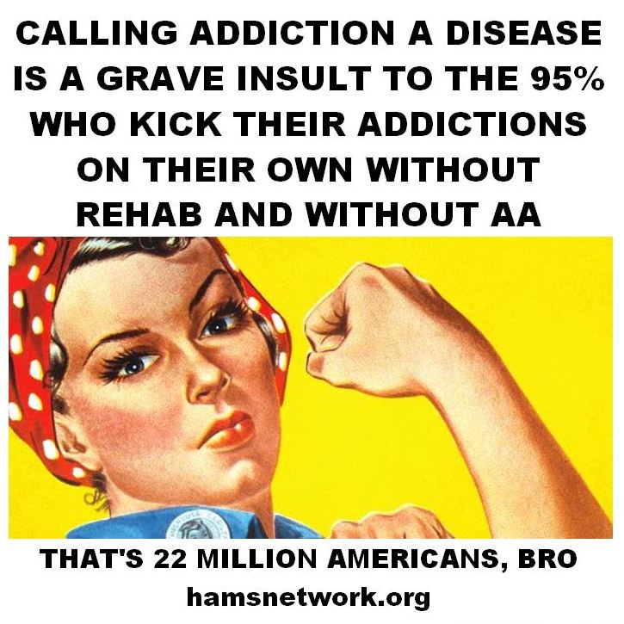

Slide 23
NESARC drug list
1. Sedatives, for example, sleeping pills, bar-bit-your-ates, Seconal, Kway-ludes, or Khlor-all Hydrate
2. Tranquilizers or anti-anxiety drugs, for example, Valium, Librium, muscle relaxants, or Zanax
3. Painkillers, for example, Codeine, Darvon, Per-ko-dan, Dill-odd-id, or Demerol
4. Stimulants, for example, Pray-lude-in, Benzadrine, Methadrine, uppers, or speed
5.Mariwa-na, hash, THC, or grass
6. Cocaine or crack
7. Hallucinogens, for example, Ecstasy/MDMA, LSD, mescaline, Sillosy-bin, PCP, angel dust, or pay-o-tee
8. Inhalants or solvents, for example, a-mill nitrate, nitrous oxide, glue, tol-u-een or gasoline
9.Heroin
10. Any OTHER medicines, or drugs, or substances, for example, steroids, Elavil, Thorazine or Haldol

Slide 24
How Addictive Are Different Substances? (Anthony, 1994, NCS)
Comparative Epidemiology of Dependence on Tobacco, Alcohol, Controlled Substances, and Inhalants
Notes:
Anthony, J. C., Warner, L. A., & Kessler, R. C. (1994). Comparative epidemiology of dependence on tobacco, alcohol, controlled substances, and inhalants: basic findings from the National Comorbidity Survey. Experimental and Clinical Psychopharmacology, 2(3), 244.
http://psycnet.apa.org/journals/pha/2/3/244/

Slide 25
NESARC Showed Roughly Twice The Likelihood Of Nicotine Dependence Compared to NCS
Notes:
Lopez-Quintero, C., Cobos, J. P. D. L., Hasin, D. S., Okuda, M., Wang, S., Grant, B. F., & Blanco, C. (2011). Probability and predictors of transition from first use to dependence on nicotine, alcohol, cannabis, and cocaine: Results of the National Epidemiologic Survey on Alcohol and Related Conditions (NESARC). Drug and alcohol dependence, 115(1), 120-130.
http://www.ncbi.nlm.nih.gov/pubmed/21145178

Slide 26
NESARC Also Showed Much Greater Probability Of Transitioning From Recreational To Problematic Use of Prescription drugs than NCS
Past year prescription opioid use/dependence 12.9% for non-medical users
Notes:
Huang, B., Dawson, D. A., Stinson, F. S., Hasin, D. S., Ruan, W., Saha, T. D., ... & Grant, B. F. (2006). Prevalence, correlates, and comorbidity of nonmedical prescription drug use and drug use disorders in the United States: Results of the National Epidemiologic Survey on Alcohol and Related Conditions. Journal of Clinical Psychiatry.
http://www.ncbi.nlm.nih.gov/pubmed/16889449
Becker, W. C., Sullivan, L. E., Tetrault, J. M., Desai, R. A., & Fiellin, D. A. (2008). Non-medical use, abuse and dependence on prescription opioids among US adults: psychiatric, medical and substance use correlates. Drug and alcohol dependence, 94(1), 38-47.
http://www.ncbi.nlm.nih.gov/pubmed/18063321

Slide 27
Recovery Isn’t Necessarily Abstinence from Drug of Choice
NESARC found that about half of those who recovered from alcohol dependence drank at problem free levels
Half abstained from alcohol
About 10% of dependent cigarette smokers recover by becoming non-daily non-dependent smokers
We have less data on hard drug users but it appears that the number who moderate their drug use lies between 50% and 10%

Slide 28
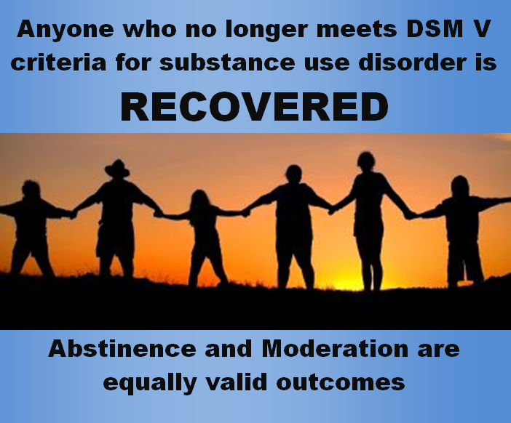

Slide 29
Controlled Nicotine Use
25% of Americans who smoke are nondaily smokers
10% of British smokers are nondaily smokers
70% of American college students who smoke are nondaily smokers
36% of New York City current smokers are nondaily smokers
2/3 of Central American smokers are nondaily smokers
The number of nondaily smokers is steadily increasing in the US
Notes:
West, R., & Shiffman, S. (2007). Fast facts: smoking cessation. Oxford: Health Press Limited.
http://www.symbicort.com/content/dam/website-services/global/symbicort-com/FF%20SmokingCess2e.pdf
'Chippers' Challenge Concepts Of Smoking Addiction
by Brenda Wilson NPR
January 22, 2009
http://www.npr.org/templates/story/story.php?storyId=99690624
Sacks, R., Coady, M. H., Mbamalu, I. G., Johns, M., & Kansagra, S. M. (2012). Exploring the next frontier for tobacco control: Nondaily smoking among New York City adults. Journal of environmental and public health, 2012.
http://www.ncbi.nlm.nih.gov/pubmed/22685481
http://www.hindawi.com/journals/jeph/2012/145861/

Slide 30
Number of cigarettes per day increases with age until smokers are in their 40 s and then declines
Hassmiller et al. (2003) report that 10% of Americans have switched from daily (dependent) cigarette smoking to non-daily (non-dependent) cigarette smoking in their lifetimes.
Annually in various countries world-wide, 1–7% of daily smokers convert to non-daily smoking. Such conversions may be increasing, as the US Behavioral Risk Factor Survey (Porter et al. 2003) and other US surveys are showing a dramatic rise in non-daily smoking over time.
A small number of daily smokers report large reductions in cigarettes per day (i.e. ≥50% reduction); this is reduction with dependence.
Notes:
Hassmiller, K. M., Warner, K. E., Mendez, D., Levy, D. T., & Romano, E. (2003). Nondaily smokers: who are they?. American Journal of Public Health, 93(8), 1321-1327.
http://ajph.aphapublications.org/doi/abs/10.2105/AJPH.93.8.1321
http://www.ncbi.nlm.nih.gov/pmc/articles/PMC1447964/

Slide 31
One Year Smoking Reductions by a Cohort Desiring to Cut Back (Glasgow 2009 intent to treat)
Notes:
Glasgow, R. E., Gaglio, B., Estabrooks, P. A., Marcus, A. C., Ritzwoller, D. P., Smith, T. L., ... & France, E. K. (2009). Long-term results of a smoking reduction program. Medical care, 47(1), 115-120.
http://www.ncbi.nlm.nih.gov/pubmed/19106739
http://www.ucdenver.edu/academics/colleges/PublicHealth/community/CEPEG/WkProducts/Publications/Documents/16Long-TermResults.pdf

Slide 33
Cigarette related harm including lung cancer is directly dose dependent so non-daily smoking should be viewed as a positive change and not a new scourge to be battled.
Any reduction in number of cigarettes smoked per day is also a positive change

Slide 34
Reductions with Nicotine Replacement Therapy
Etter does not specify if quitters were included or excluded at 6 months, though there were few at this point so it is not a major point
Notes:
Etter, J. F., Laszlo, E., Zellweger, J. P., Perrot, C., & Perneger, T. V. (2002). Nicotine replacement to reduce cigarette consumption in smokers who are unwilling to quit: a randomized trial. Journal of clinical psychopharmacology, 22(5), 487-495.
http://journals.lww.com/psychopharmacology/Abstract/2002/10000/Nicotine_Replacement_to_Reduce_Cigarette.8.aspx
Etter, J. F., & Laszlo, E. (2007). Postintervention effect of nicotine replacement therapy for smoking reduction: a randomized trial with a 5-year follow-up. Journal of clinical psychopharmacology, 27(2), 151-155.
http://www.ncbi.nlm.nih.gov/pubmed/17414237
Etter, J. F., Laszlo, E., & Perneger, T. V. (2004). Postintervention effect of nicotine replacement therapy on smoking reduction in smokers who are unwilling to quit: randomized trial. Journal of clinical psychopharmacology, 24(2), 174-179.
http://www.ncbi.nlm.nih.gov/pubmed/17414237

Slide 35
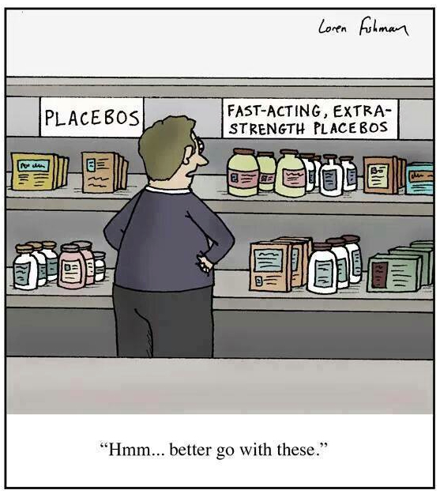

Slide 36
Percent who quit or reduced cigarettes per day by half or more

Slide 37
Controlled Heroin Use
Notes:
Warburton, H., Turnball, P. J., & Hough, J. M. (2005). Occasional and controlled heroin use: Not a problem?. York: Joseph Rowntree Foundation.
http://www.jrf.org.uk/system/files/1859354254.pdf
McSweeney, T., & Turnbull, P. J. (2007). Exploring user perceptions of occasional and controlled heroin use: A follow-up study. Joseph Rowntree Foundation.
http://www.jrf.org.uk/sites/files/jrf/2079-heroin-controlled-drugs.pdf

Slide 38
Warburton et al. (2005) interviewed 51 controlled heroin users and found the following patterns:
stable mid- to long-term non-dependent use without ever incurring a period of dependence (13 respondents)
mid- to long-term non-dependent use after experiencing a period of dependent/problematic use (22 respondents)
stable mid- to long-term controlled dependent use (nine respondents)
transition (i.e. recent dependent or problematical use) and new using (seven respondents)

Slide 39
Controlled Heroin Use Factors
the application of ‘using rules’ – including rules about frequency and amount of heroin used, access to the drug, where an individual used heroin and with whom
their expectations of the physical and mental effects of heroin
life structures and commitments – for example, being employed, having stable accommodation arrangements, maintaining good family and social relationships, and having non-heroin-using interests and friends
attitudes and personality traits – such as a generalized ability to exercise control over their lives
their own experience of heroin use, or indirect experience – such as witnessing the damage done by heroin to friends’ lives
the perception of the stigma attached to uncontrolled or dependent use, and their desire to avoid stigmatization

Slide 40
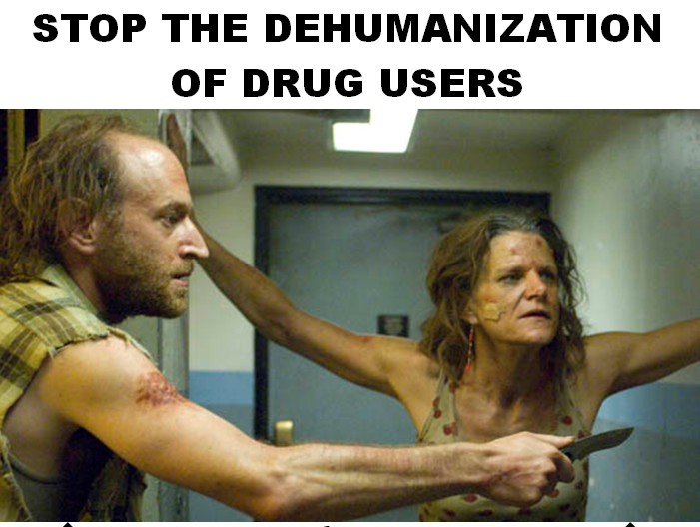
What drug users look like on TV

Slide 41
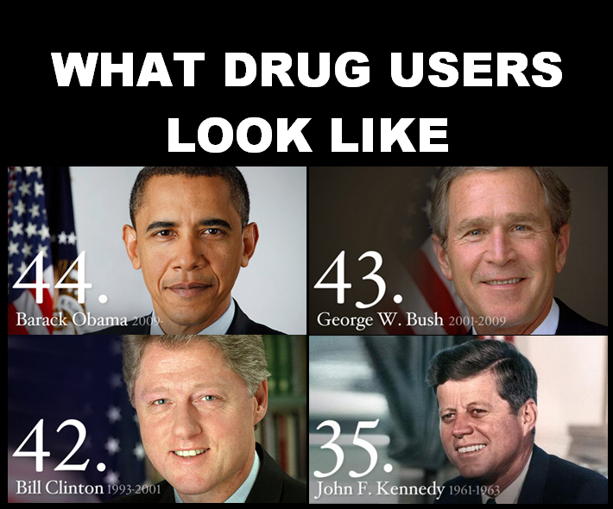
What drug users look like in real life

Slide 42
Controlled Crack Smoking
Average abstinence period for abstainers 7.33 months
Notes:
Daniulaityte, R., Carlson, R. G., & Siegal, H. A. (2007). “Heavy users,”“controlled users,” and “quitters”: Understanding patterns of crack use among women in a Midwestern city. Substance use & misuse, 42(1), 129-152.
http://www.ncbi.nlm.nih.gov/pubmed/17366129

Slide 43
Protective and Risk Factors for Controlled Crack Use (Ohio 2007)
Controlled Crack Use - protective factors:
  using rules
  Financial planning
  employment
  family support
  children
  non-using friends
  stigma of uncontrolled use
Uncontrolled Crack Use - risk factors
  family enabling
  unemployment
  all using friends
Controlled users often reported earlier periods of uncontrolled use - return to moderation is possible

Slide 44
Other Studies of Controlled Crack Use
Jackson-Jacobs studied 4 controlled crack users on a college campus and outlined the rules used to keep use under control. 3 dominant rituals were: 1) cooking from powder; 2) cooking small batches; 3) passing the pipe. One of the four became an uncontrolled user
German and Sterk classed inner city crack users in Atlanta into 4 categories: 1) stable; 2) tempted; 3) grappling; 4) immersed
Notes:
Jackson-Jacobs, C. (2001). Refining rock: Practical and social features of self-control among a group of college-student crack users. Contemp. Drug Probs., 28, 597.
http://curtisjacksonjacobs.files.wordpress.com/2011/03/refining-rock.pdf
Jackson‐Jacobs, C. (2004). hard drugs in a soft context. The Sociological Quarterly, 45(4), 835-856.
http://onlinelibrary.wiley.com/doi/10.1111/j.1533-8525.2004.tb02316.x/abstract
http://curtisjacksonjacobs.files.wordpress.com/2011/03/hard-drugs-in-a-soft-context.pdf
German, D., & Sterk, C. E. (2002). Looking beyond stereotypes: exploring variations among crack smokers. Journal of psychoactive drugs, 34(4), 383-392.
http://www.ncbi.nlm.nih.gov/pubmed/12562106

Slide 46
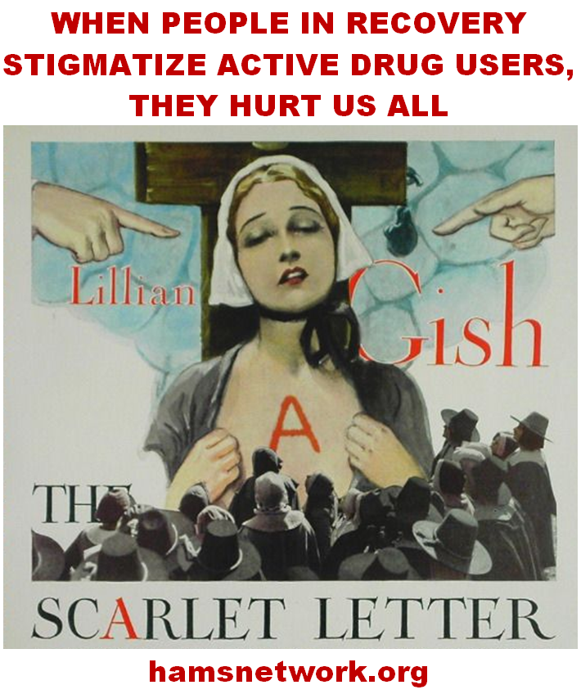

Slide 47
Alcohol
Recovery from alcohol dependence should not tied to a specific drink number—but to absence of impairment
NESARC found over half of people who recovered from alcohol dependence did so via controlled drinking
Notes:
Alcoholism Isn’t What It Used To Be
NIAAA Spectrum 1, 1
http://www.spectrum.niaaa.nih.gov/archives/v1i1Sept2009/features/Alcoholism.html

Slide 48
Controlled Alcohol Dependence in Wet Housing
Notes:
University of Washington. January 19, 2012
Homeless heavy drinkers imbibe less when housing allows alcohol
Molly McElroy
http://www.washington.edu/news/2012/01/19/homeless-heavy-drinkers-imbibe-less-when-housing-allows-alcohol/
Collins, S. E., Malone, D. K., Clifasefi, S. L., Ginzler, J. A., Garner, M. D., Burlingham, B., ... & Larimer, M. E. (2012). Project-based Housing First for chronically homeless individuals with alcohol problems: Within-subjects analyses of 2-year alcohol trajectories. American journal of public health, 102(3), 511-519.
http://www.ncbi.nlm.nih.gov/pubmed/22390516
http://www.ncbi.nlm.nih.gov/pmc/articles/PMC3487630/

Slide 49
Naltrexone + HR Therapy in a Homeless Cohort with Chronic Alcohol Dependence
24 homeless individuals with severe alcohol dependence showed the following results at 12 week follow-up after treatment with naltrexone and harm reduction counseling:
  decrease in alcohol craving (33%)
  decrease in typical alcohol use (25%)
  decrease in peak use (34%)
  decrease in frequency (17%)
  decrease in problems (60%)
Participants: 54.8% Housing First residents, 45.2% Currently homeless

Slide 50
Maintenance, Substitution, and Drug Switching
Opioid maintenance: methadone, bupe, heroin assisted treatment
Nicotine maintenance
Cannabis substitution
Stepping down from a harder to softer drug
Controlled drinking in former opioid addicts
ALL of the above are FULL RECOVERY if impairment is eliminated and PARTIAL RECOVERY if impairment is reduced

Slide 51
Heroin Assisted Treatment (HAT)
Heroin Assisted Treatment (HAT) is available in the UK, Switzerland, Germany, The Netherlands, and with limits in Canada
Heroin Assisted Treatment (HAT) is for users who do not do well with methadone or bupe
Heroin Assisted Treatment (HAT) has demonstrated reductions in crime and use of street heroin along with improvements in drug user health and well-being

Slide 52
Heroin Assisted Treatment (HAT) for Methadone Resistant Heroin Users
Significant for intent to treat analysis
Significant for intent to treat analysis
Notes:
Haasen, C., Verthein, U., Degkwitz, P., Berger, J., Krausz, M., & Naber, D. (2007). Heroin-assisted treatment for opioid dependence Randomised controlled trial. The British Journal of Psychiatry, 191(1), 55-62.
http://bjp.rcpsych.org/content/191/1/55.short
Strang, J., Metrebian, N., Lintzeris, N., Potts, L., Carnwath, T., Mayet, S., ... & Forzisi, L. (2010). Supervised injectable heroin or injectable methadone versus optimised oral methadone as treatment for chronic heroin addicts in England after persistent failure in orthodox treatment (RIOTT): a randomised trial. The Lancet, 375(9729), 1885-1895.
http://donaldmacpherson.ca/wp-content/uploads/2010/05/British-Heroin-Trial-Results.pdf

Slide 53
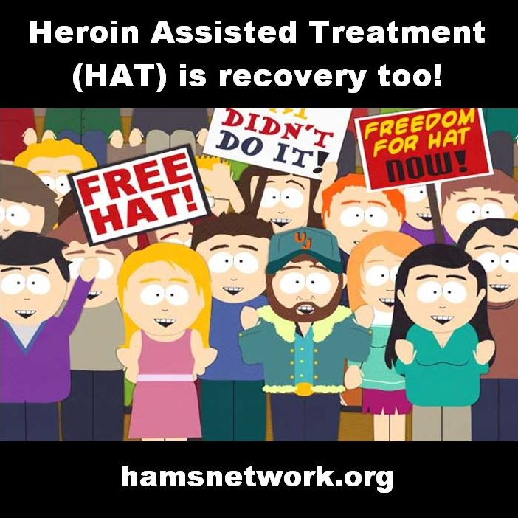

Slide 54
Nicotine Maintenance
Non-carcinogenic options for Nicotine Maintenance include: Swedish Snus, Electronic cigarettes, gum, patch, inhaler, and lozenge: These show dependence without harm
Other forms of oral tobacco are less carcinogenic than cigarettes and reduce risk
WARNING: low tar and low nicotine cigarettes can be WORSE than high tar and high nicotine cigarettes due to compensatory smoking, high nicotine and low tar is safest but also most addictive

Slide 55
Cannabis Is the Exit Drug
Reiman has found evidence of successful cannabis substitution for all drug dependencies including alcohol, opioids, stimulants, tranquilizers, and others
Notes:
Reiman, A. (2009). Cannabis as a substitute for alcohol and other drugs. Harm Reduction Journal, 6(1), 35.
http://www.ncbi.nlm.nih.gov/pubmed/19958538
Lucas, P., Reiman, A., Earleywine, M., McGowan, S. K., Oleson, M., Coward, M. P., & Thomas, B. (2012). Cannabis as a substitute for alcohol and other drugs: A dispensary-based survey of substitution effect in Canadian medical cannabis patients. Addiction Research & Theory, 21(5), 435-442.
http://informahealthcare.com/doi/abs/10.3109/16066359.2012.733465
Mikuriya, T. H. (2003). Cannabis As a Substitute for Alcohol. Journal of Cannabis Therapeutics, 3(1).
Mikuriya, T. H. (2004). Cannabis as a substitute for alcohol: a harm-reduction approach. Journal of Cannabis Therapeutics, 4(1), 79-93.
http://www.tandfonline.com/doi/abs/10.1300/J175v04n01_04#.VB7K-7G02Qg

Slide 56
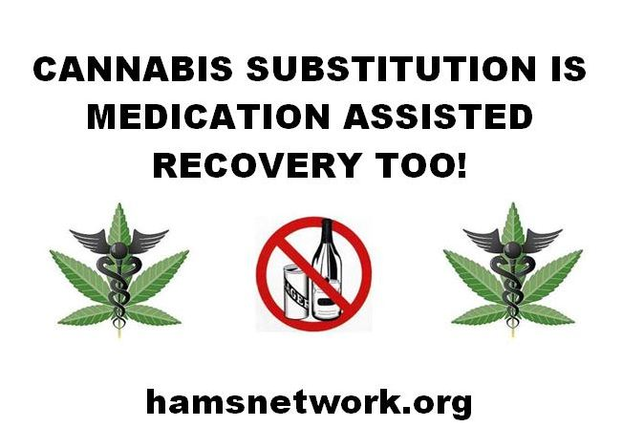

Slide 57
Can Ex-Narcotics Addicts Drink Safely?
Some can and some can not
There is no good epidemiological data to tell how many can and how many can not
William White reviewed the anecdotal data from people given “drinking privileges” at TCs and found that somewhere between 10% and 80% of ex narcotics addicts developed alcohol dependence if they attempted social drinking
The current addiction treatment policy of mandating abstinence from all substances except nicotine and caffeine is due solely to this anecdotal evidence
San Patrignano TC in Italy currently serves wine at every lunch and dinner (Lala Straussner, personal communication)
Notes:
White, W. (2007) Can recovering drug addicts drink? A historical footnote.
Counselor, 8(6), 36-41.
http://www.williamwhitepapers.com/pr/2007CanDrugAddictsDrink.pdf

Slide 58
Poorer prognosis for social drinking in ex-narcotic addicts is associated with the following factors:
  1) a family history of alcohol problems
  2) a history of alcohol problems predating the emergence of another pattern of drug dependence
  3) co-addiction to alcohol and other drugs prior to entry into treatment
  4) the presence of a co-occurring psychiatric illness
  5) a history of childhood victimization
  6) later developmental trauma (e.g., loss via death or separation)
  7) enmeshment in a heavy drinking social network.

Slide 59
Changing Route or Potency
Switching from whiskey to beer
Snorting instead of shooting for heroin or cocaine
These strategies can result in partial or full recovery depending on whether there is reduction or elimination of impairment

Slide 60
Cross Addiction Is a Myth
People who overcome an addiction are only half as likely to develop a new addiction as those that don’t
Notes:
Blanco, C., Okuda, M., Wang, S., Liu, S. M., & Olfson, M. (2014). Testing the Drug Substitution Switching-Addictions Hypothesis: A Prospective Study in a Nationally Representative Sample. JAMA psychiatry.
http://www.ncbi.nlm.nih.gov/pubmed/25208305
http://archpsyc.jamanetwork.com/article.aspx?articleid=1901525

Slide 61
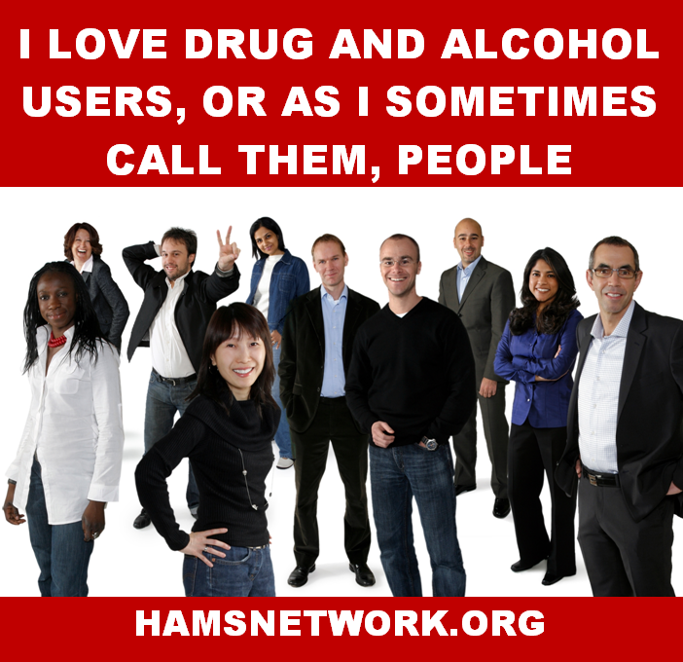

Slide 62
Can one be dependent on one substance and in recovery from another?
This is very common if you think of the numbers of people who have recovered from alcohol or heroin dependence but still have nicotine dependence
Generally this is possible unless the substances are cross-tolerant – i. e. in the same category
Scherer et al. found that 59.5% of current heroin and/or cocaine users reported natural recovery from problematic alcohol misuse
Notes:
Scherer, M., Trenz, R. C., Harrell, P., Altintoprak, E., Mancha, B., & Latimer, W. W. (2012). Desistance from problematic alcohol use without treatment among active heroin and cocaine users. Addiction Research & Theory, 21(3), 227-234.
http://informahealthcare.com/doi/abs/10.3109/16066359.2012.705400

Slide 63
Drug Use Typology
Mushing everything together into the category SUD like the DSM 5 does misses a lot – we suggest the following typology
  dependent/ non-dependent
  chaotic & problematic/ non- chaotic & non-problematic
  controlled/uncontrolled
These patterns are independent of each other and can be occur in all possible combinations
For example:
  Methadone Maintenance - dependent, controlled, and non- chaotic & non-problematic
  DSM IV Alcohol Abuse - non-dependent but chaotic & problematic

Slide 64
Celebrate Every Positive Change
There are many ways to recover and they are all valid
There is no reason to point fingers and say one person’s recovery is less valid than any other person’s

Slide 65
Lifetime Psychiatric Comorbidity and Substance Use Disorder in Community Samples (ECA)
Notes:
Regier, D. A., Farmer, M. E., Rae, D. S., Locke, B. Z., Keith, S. J., Judd, L. L., & Goodwin, F. K. (1990). Comorbidity of mental disorders with alcohol and other drug abuse: results from the Epidemiologic Catchment Area (ECA) study. Jama, 264(19), 2511-2518.
http://www.ncbi.nlm.nih.gov/pubmed/2232018

Slide 66
National Comorbidity Survey (90-92)
Notes:
The prevalence of psychiatric comorbidity.
Kessler, Ronald C.
Wetzler, Scott (Ed); Sanderson, William C. (Ed), (1997). Treatment strategies for patients with psychiatric comorbidity. An Einstein psychiatry publication, No. 14., (pp. 23-48). Hoboken, NJ, US: John Wiley & Sons Inc, xvi, 368 pp.
http://psycnet.apa.org/psycinfo/1997-08623-002

Slide 67
Antisocial Behavior and Substance Use Disorder in Community Samples
Notes:
Goldstein, R. B., Dawson, D. A., Saha, T. D., Ruan, W., Compton, W. M., & Grant, B. F. (2007). Antisocial Behavioral Syndromes and DSM‐IV Alcohol Use Disorders: Results From the National Epidemiologic Survey on Alcohol and Related Conditions. Alcoholism: Clinical and Experimental Research, 31(5), 814-828.
http://www.ncbi.nlm.nih.gov/pubmed/17391341

Slide 68
Notes:
Goldstein, R. B., Compton, W. M., Pulay, A. J., Ruan, W., Pickering, R. P., Stinson, F. S., & Grant, B. F. (2007). Antisocial behavioral syndromes and DSM-IV drug use disorders in the United States: Results from the National Epidemiologic Survey on Alcohol and Related Conditions. Drug and alcohol dependence, 90(2), 145-158.
http://www.ncbi.nlm.nih.gov/pubmed/17433571
http://www.ncbi.nlm.nih.gov/pmc/articles/PMC2633099/

Slide 69
Adult antisocial behavior not included
Funny that today no one says that smoking cigarettes hijacks your brain and makes you rob little old ladies
Notes:
Chen, L. S., Xian, H., Grucza, R. A., Saccone, N. L., Wang, J. C., Johnson, E. O., ... & Bierut, L. J. (2012). Nicotine dependence and comorbid psychiatric disorders: Examination of specific genetic variants in the< i> CHRNA5-A3-B4</i> nicotinic receptor genes. Drug and alcohol dependence, 123, S42-S51.
http://www.ncbi.nlm.nih.gov/pmc/articles/PMC3376673/

Slide 70
Recovery and Comorbidity
Most people with Alcohol Use Disorder and many people with Drug Use Disorder do not engage in antisocial behaviors so it is insane to make it a part of recovery to force everyone to confess to being a thief or pathological liar
Since psychiatric comorbidity is very common with Substance Use Disorders, recovery from these comorbidities is an important part of recovery from Substance Use Disorder for many people

Slide 71
Progression
Addictive progression is the rare exception and not the rule for dependence
Bill Miller found that only 5% of subjects with Alcohol Dependence showed progression in his BSCT study
As we saw above smokers begin to smoke fewer cigarettes in their 40s and thereafter

Slide 72
Miller’s Outcomes

Slide 73
Progression in NESARC
Notes:
Flórez-Salamanca, L., Secades-Villa, R., Hasin, D. S., Cottler, L., Wang, S., Grant, B. F., & Blanco, C. (2013). Probability and Predictors of Transition from Abuse to Dependence on Alcohol, Cannabis, and Cocaine: Results from the National Epidemiologic Survey on Alcohol and Related Conditions. The American journal of drug and alcohol abuse, 39(3), 168-179.
http://www.ncbi.nlm.nih.gov/pubmed/23721532
http://www.ncbi.nlm.nih.gov/pmc/articles/PMC3755735/

Slide 74
What Is Recovery?
Recovery means the elimination of drug/alcohol related problems
Partial recovery is any reduction in drug/alcohol related problems
Recovery can mean any of the following:
  no drug/alcohol use at all
  non-dependent, non-problematic use
  and even dependent non-problematic use
partial recovery can range from anything from using clean needles to giving up drunk driving

Slide 75
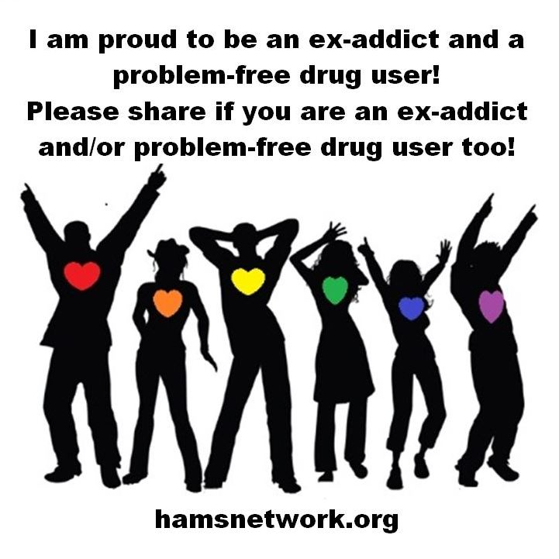

Slide 76
What We Need to Promote All Forms of Recovery
An end to the drug war
An end to discrimination against drug users – both active and former
An end to coerced treatment
Drug user equality under the law, including student loans, religious freedom, and criminal prosecution
“Disease” can not be a get out of jail free card

Slide 77
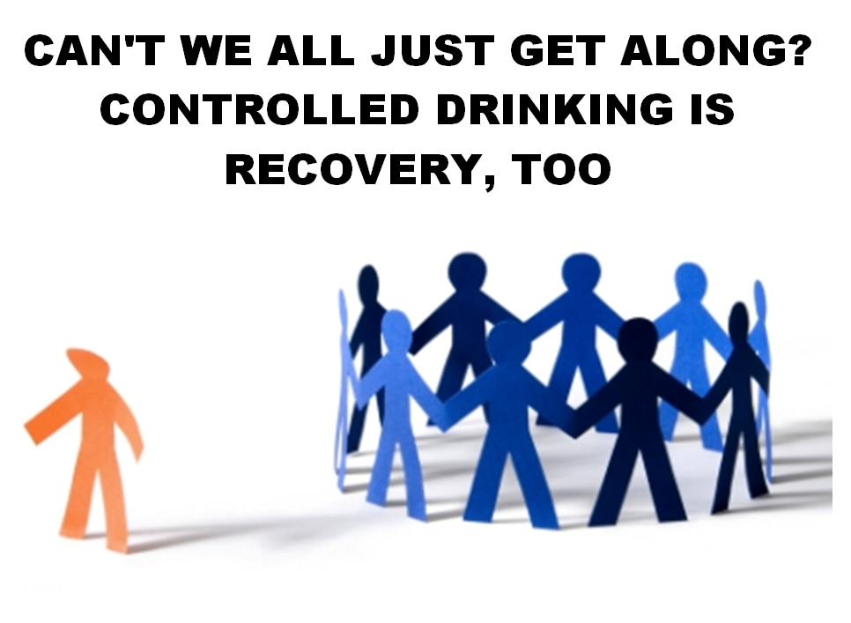
Everyone Needs a Voice in the Conversation

Slide 78
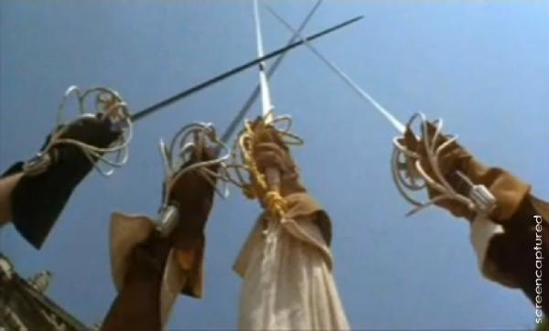
ALL FOR ONE AND ONE FOR ALL!

Slide 79
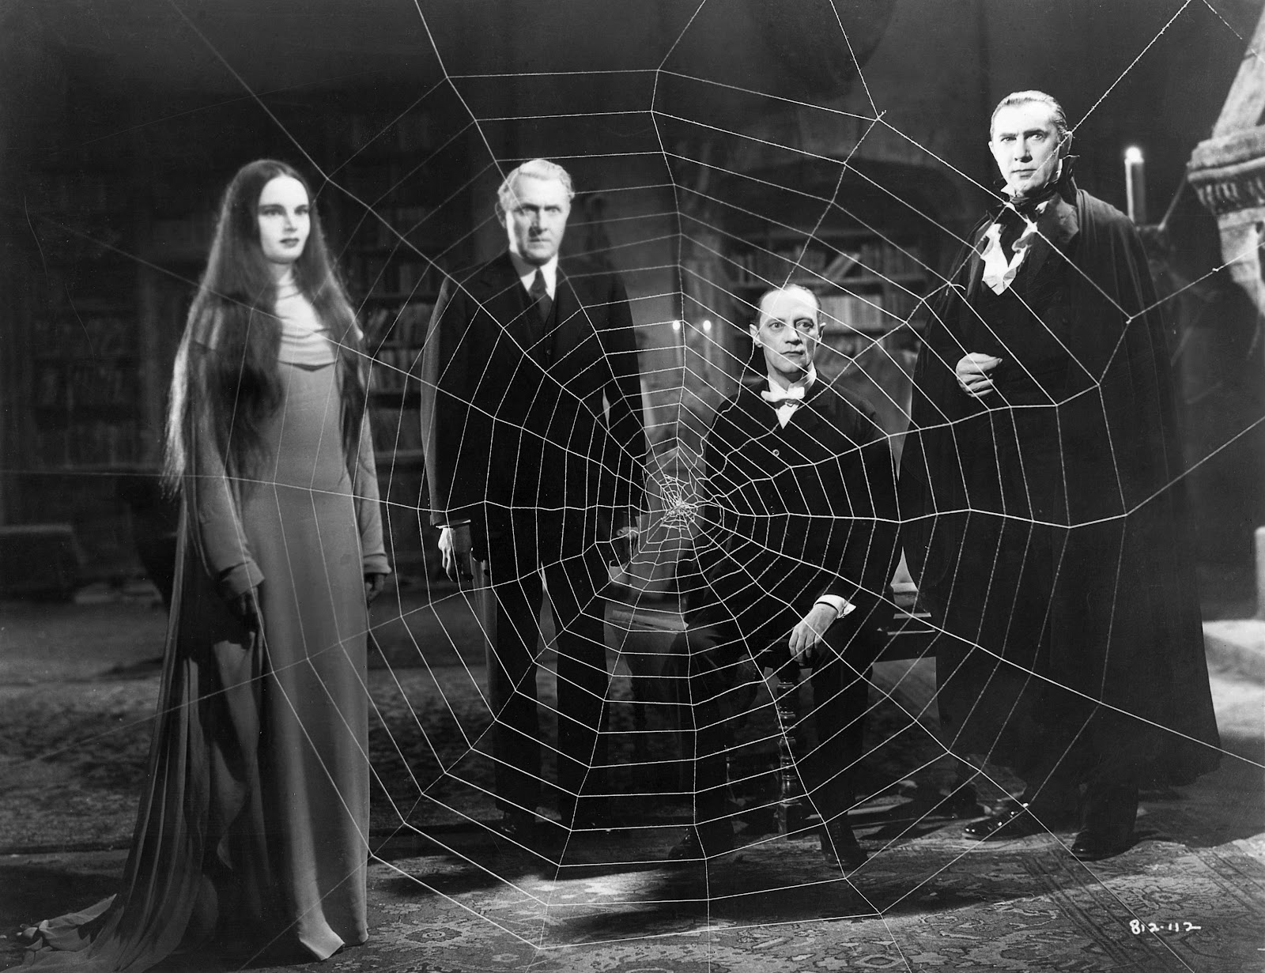
THANK
YOU

