Slide 1
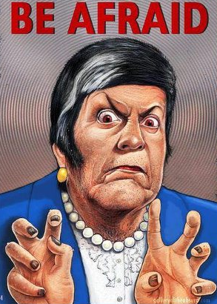
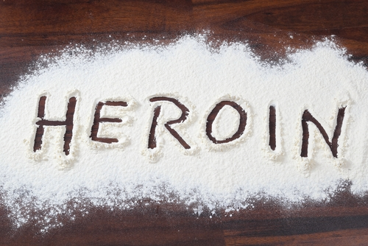
The Polydrug Poisoning Epidemic and the Killer Heroin Meme

Slide 2
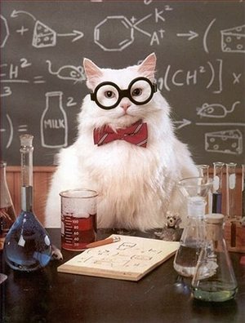
For every complex problem there is an answer that is clear, simple, and wrong.
--H. L. Mencken

Slide 3

For the media the answer is:
BLAME
HEROIN!
BLAME
HEROIN!

Slide 4
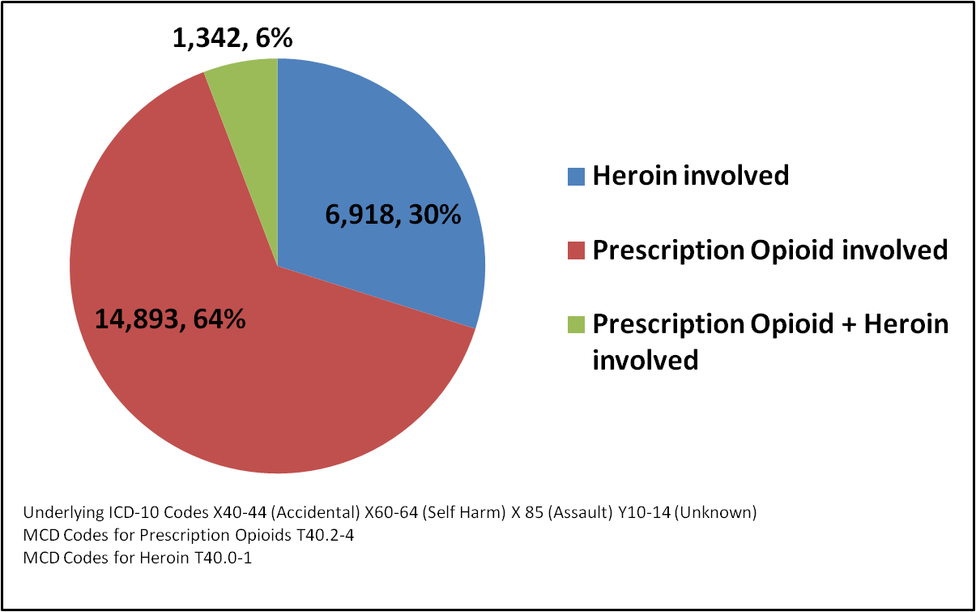
Opioid involved deaths USA 2013 (23,153 total)
Notes:
CDC WONDER http://wonder.cdc.gov/mcd-icd10.html

Slide 5
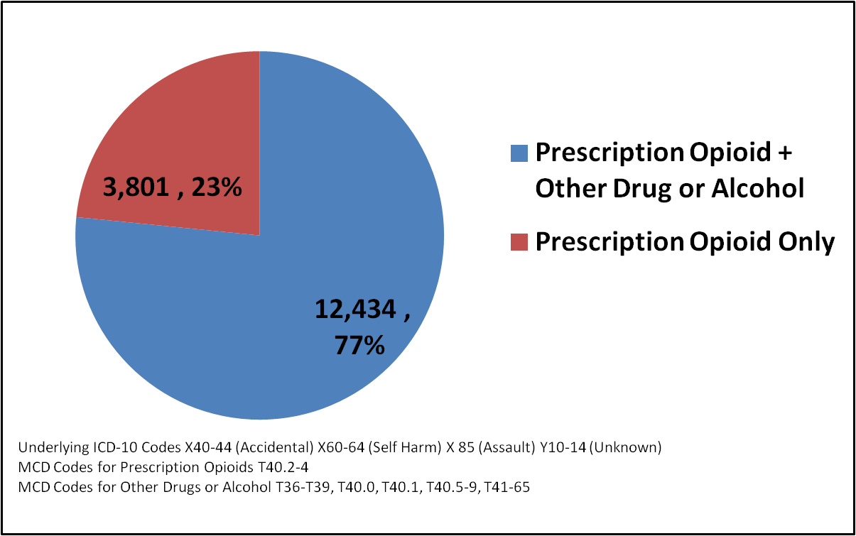
Prescription Opioid deaths involving drug mixing USA 2013
Notes:
CDC WONDER http://wonder.cdc.gov/mcd-icd10.html

Slide 6
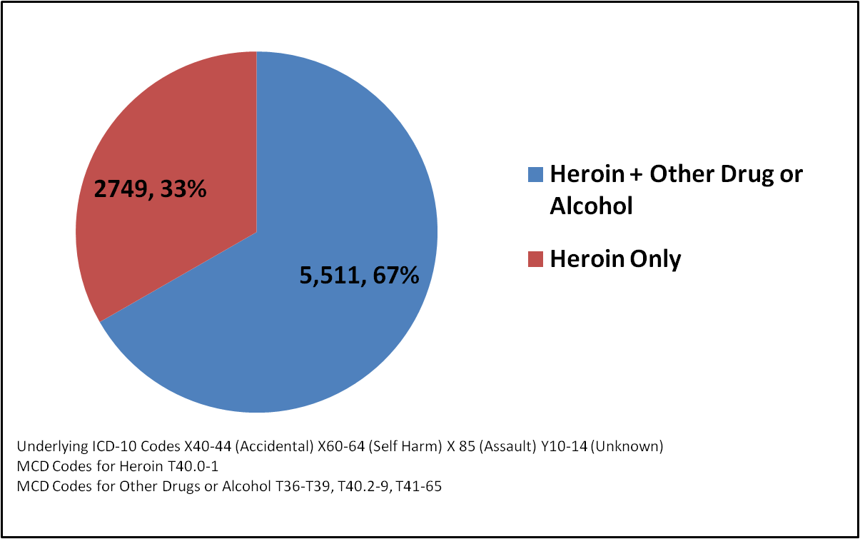
Heroin deaths involving drug mixing USA 2013
Notes:
CDC WONDER http://wonder.cdc.gov/mcd-icd10.html

Slide 7
UNDERCOUNTING
Jones et al. (2013) “Death certificate data have limitations, but they are the sole source for detailed death information at the national level. This analysis is limited by the 25% of death certificates in which the type of drugs involved was not specified, an omission due to lack of toxicological testing or failure to record the results of such tests on the death certificate. Therefore, the numbers reported in this analysis are undercounts. Additionally, the degree to which drugs are specified on death certificates might vary across the United States and therefore differentially undercount types of drugs more common in areas in which death certificates are less complete.”
Notes:
Jones, C. M., Mack, K. A., & Paulozzi, L. J. (2013). Pharmaceutical overdose deaths, United States, 2010. Jama, 309(7), 657-659.

Slide 8
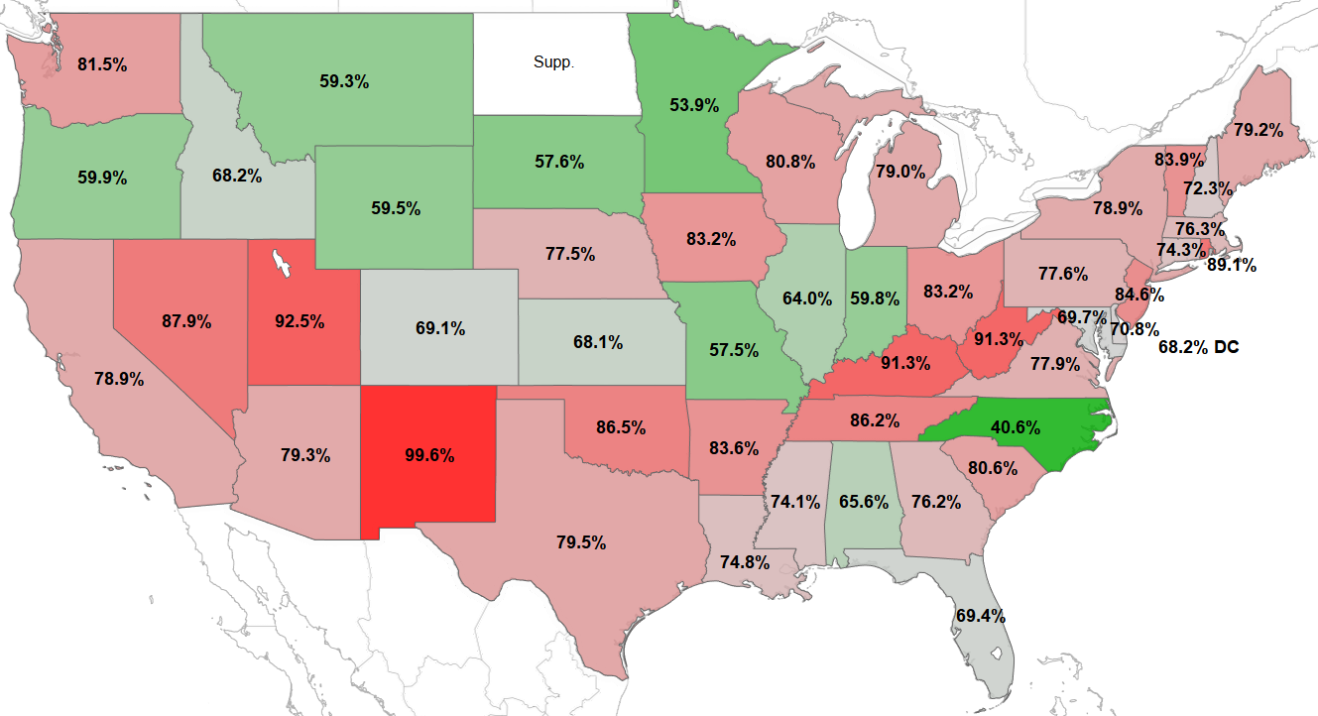
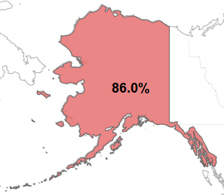
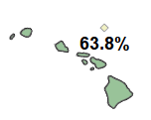
Percentage of Prescription Opioid deaths involving drug mixing as reported by state 2013
MAX, New Mexico, 99.6%
MIN, North Carolina, 40.6%
States with fewer than 10 deaths are suppressed by CDC
Notes:
CDC WONDER http://wonder.cdc.gov/mcd-icd10.html

Slide 9
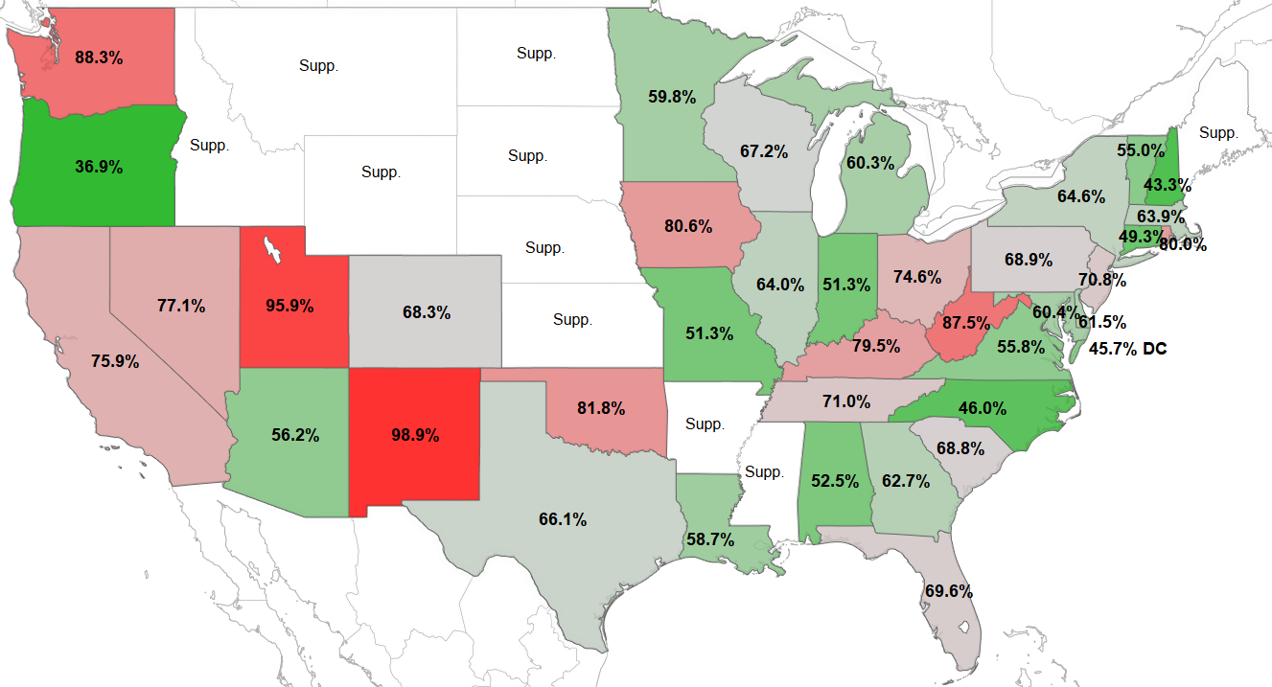
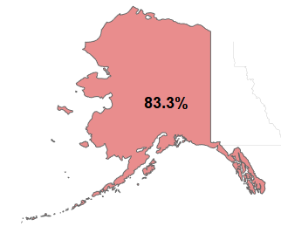
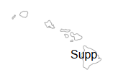
Percentage of Heroin deaths involving drug mixing as reported by state 2013
MAX, New Mexico, 98.9%
MIN, Oregon, 36.9%
States with fewer than 10 deaths are suppressed by CDC
Notes:
CDC WONDER http://wonder.cdc.gov/mcd-icd10.html

Slide 10
Do these states actually have low rates of drug mixing or do they have lots of under-reporting of drug mixing deaths? We don’t have any way to know for sure.

Slide 11
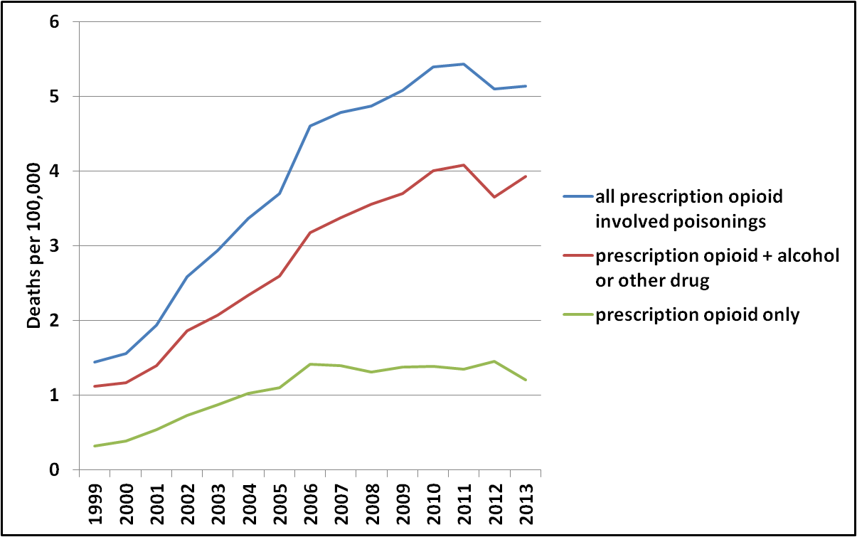
Prescription opioid involved deaths USA 1999-2013
Notes:
CDC WONDER http://wonder.cdc.gov/mcd-icd10.html

Slide 12
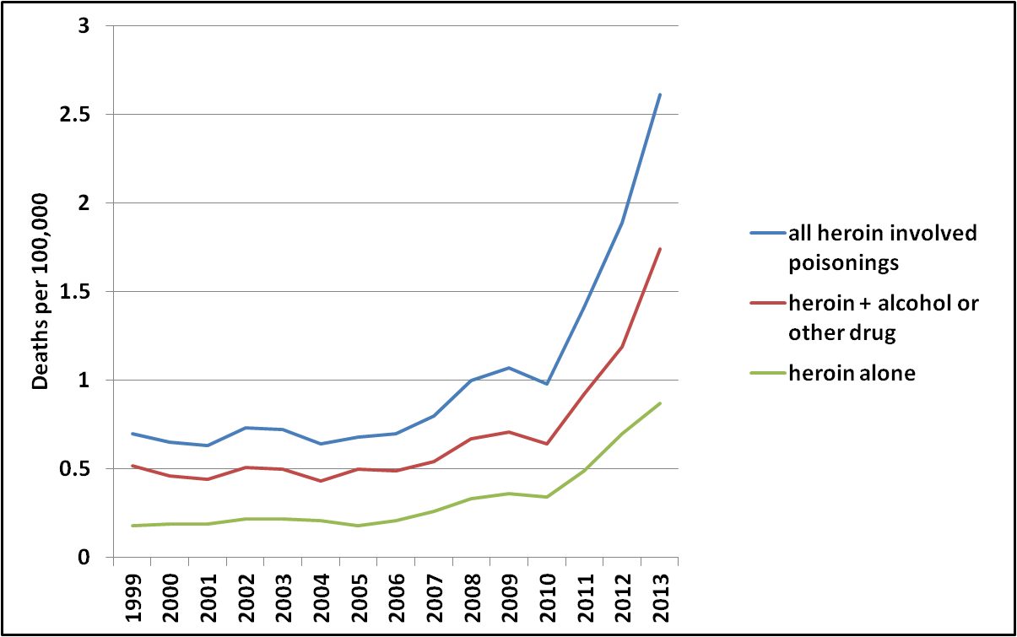
Heroin involved deaths USA 1999-2013
Notes:
CDC WONDER http://wonder.cdc.gov/mcd-icd10.html

Slide 13
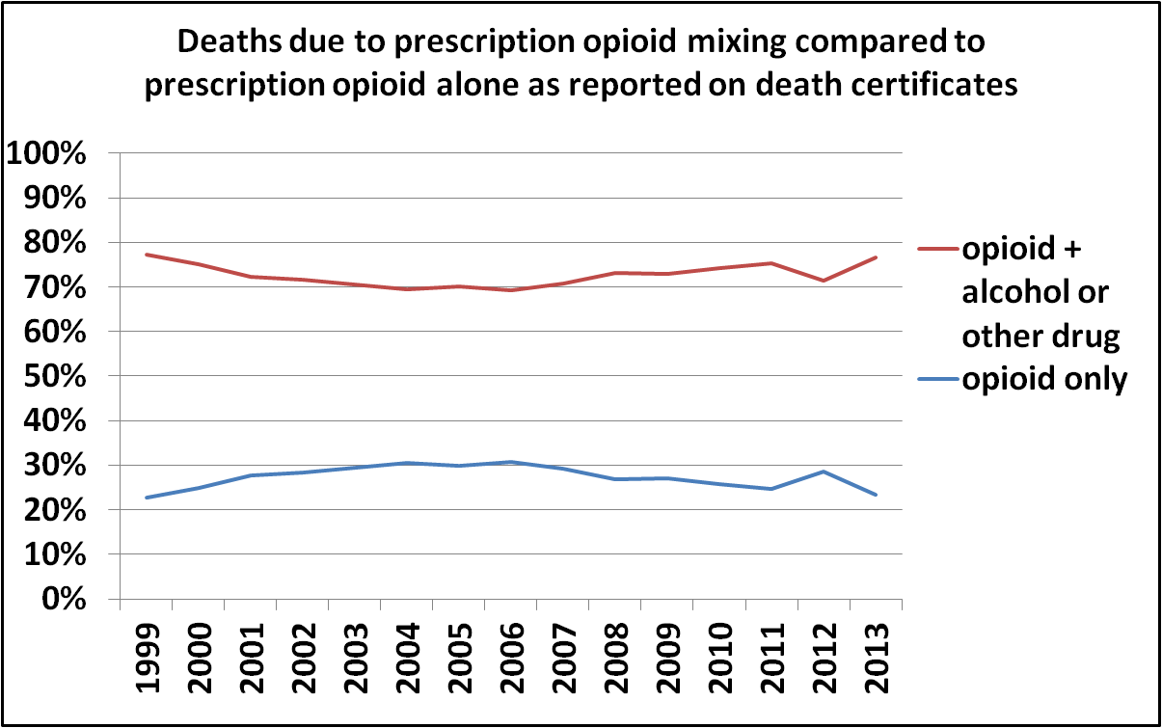
Percentage of Prescription Opioid involved deaths involving drug mixing 1999-2013
Notes:
CDC WONDER http://wonder.cdc.gov/mcd-icd10.html

Slide 14
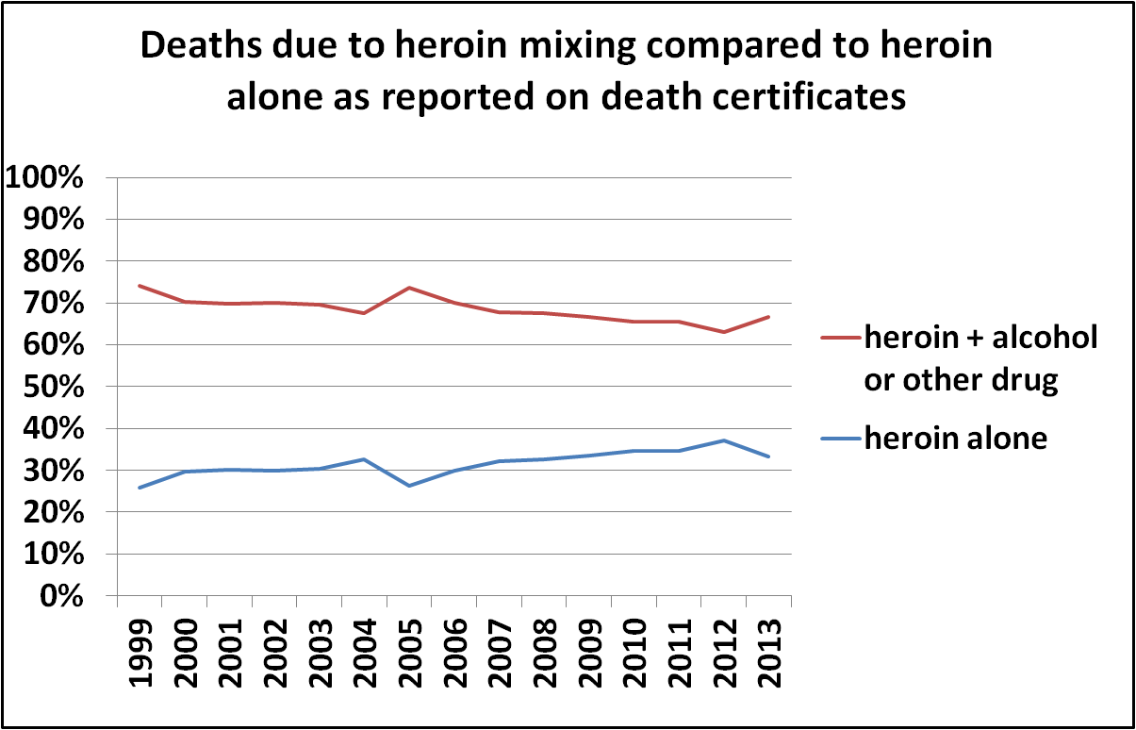
Percentage of Heroin involved deaths involving drug mixing 1999-2013
Notes:
CDC WONDER http://wonder.cdc.gov/mcd-icd10.html

Slide 15
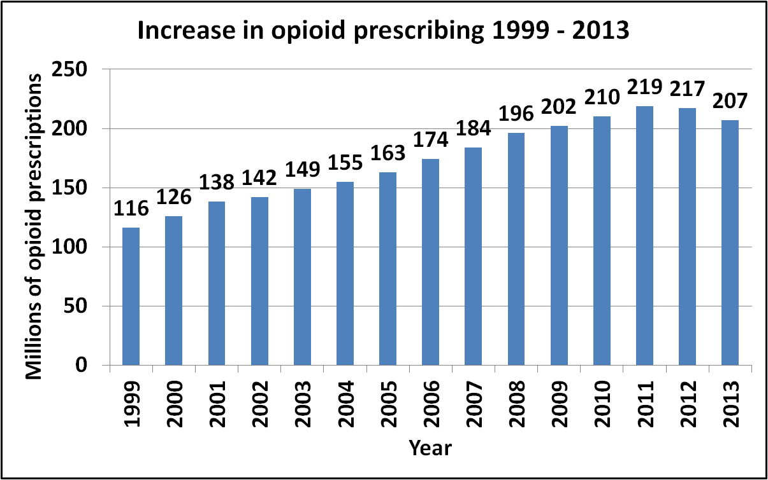
Notes:
https://www.drugabuse.gov/about-nida/legislative-activities/testimony-to-congress/2015/americas-addiction-to-opioids-heroin-prescription-drug-abuse

Slide 16
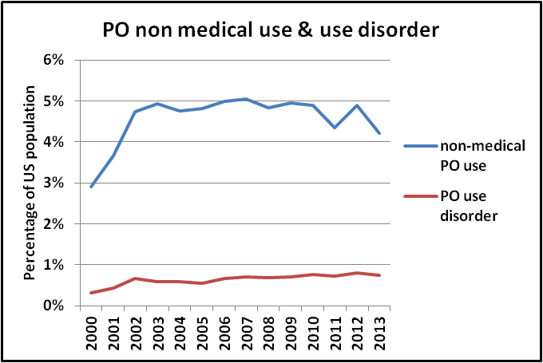
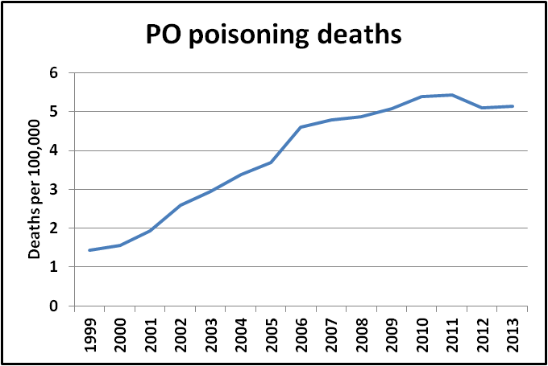
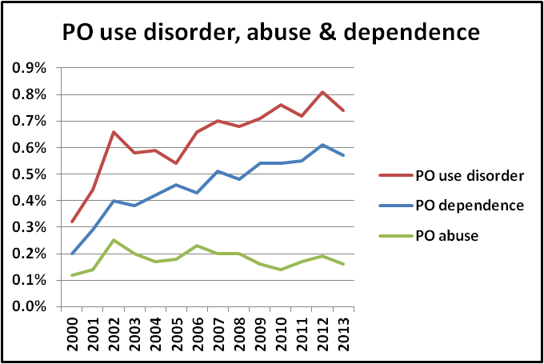
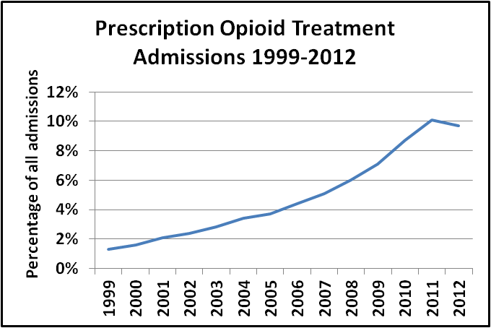
Notes:
CDC WONDER http://wonder.cdc.gov/mcd-icd10.html
NSDUH http://www.icpsr.umich.edu/icpsrweb/ICPSR/series/64
TEDS-A http://www.icpsr.umich.edu/icpsrweb/ICPSR/series/00056

Slide 17
What does the previous data suggest?
It is likely that there is a generally increase in severity of Prescription Opioid Use Disorder
It is also likely that people with Prescription Opioid Use Disorder are using bigger doses and/or more frequently
There is a probable increase in the severity of PO withdrawal and tolerance due to consumption of large doses

Slide 18
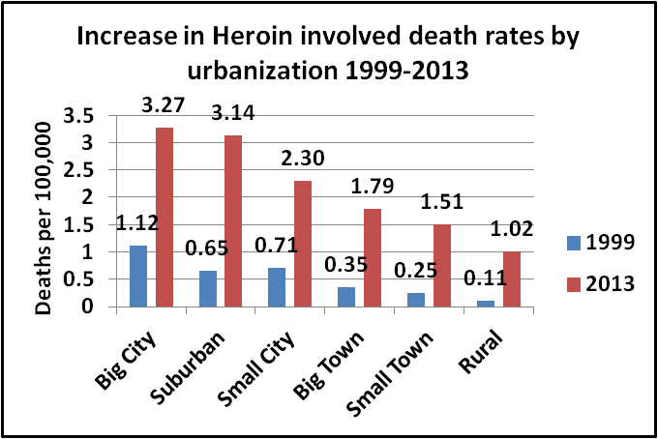
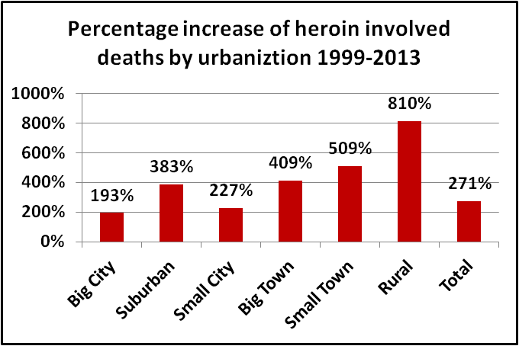
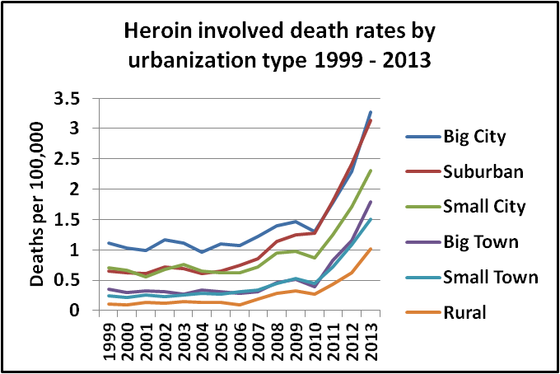
Heroin is now making its way into many suburban and rural areas where naïve users have no clue about safe use practices and no access to harm reduction services--with devastating results (T40.0, 1)
Notes:
CDC WONDER http://wonder.cdc.gov/mcd-icd10.html

Slide 19
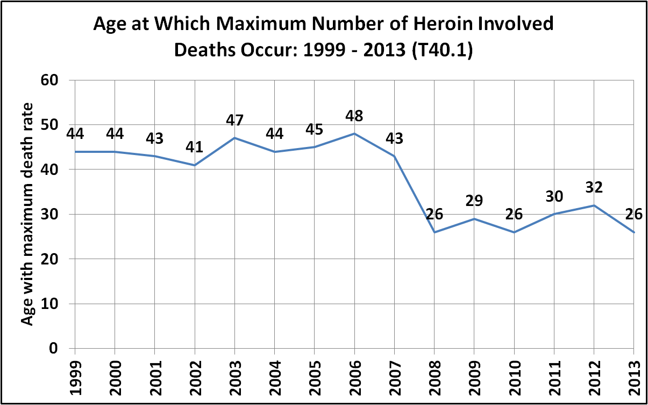
Heroin poisoning used to primarily affect an older population
Notes:
CDC WONDER http://wonder.cdc.gov/mcd-icd10.html

Slide 20
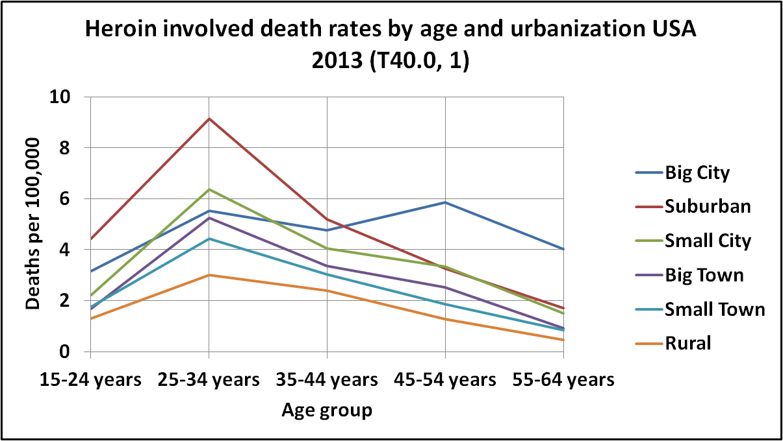
In big cities heroin poisoning still mainly affects an older population, but not in suburban, small town or rural areas
Notes:
CDC WONDER http://wonder.cdc.gov/mcd-icd10.html

Slide 21
Why hasn’t anyone talked about the drug mixing problem before?
Actually they have
As early as 1973 Brecher pointed out that most so-called heroin overdoses are polydrug poisonings
The NYC Dept of Health has published several reports stating over 90% of NYC opioid deaths are due to drug mixing
Jones et al. (2013) and a couple of other researchers have published scholarly articles on the topic

Slide 22
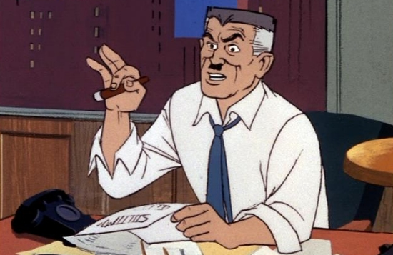
But the media remains totally clueless about the polydrug poisoning epidemic

Slide 23
Are non medical users of prescription opioids on the rise?—No
Are some prescription opioid users taking much bigger doses whether they mix or not?--Probably yes
Is heroin use on the rise?—Yes
Are the numbers of young, inexperienced, and non-urban heroin users increasing?—Yes
Is the percentage of users who mix drugs on the rise?--?????

Slide 24
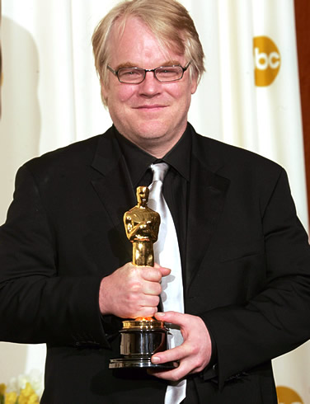
The Heroin Purity Myth
In a story in the New York Post about the death of Philip Seymour Hoffmann, New York City DEA agent John Hunt blames killer heroin and says that the heroin in New York City today is many times stronger than it was 20 years ago.

Slide 25
“New York City Heroin Weaker Than 20 Years Ago!” is not a great soundbite
Hoffman actually died of a drug cocktail involving Heroin, Cocaine, Benzos, and Amphetamine—not “KILLER HEROIN”
Notes:
http://www.oasas.ny.gov/admed/fyi/herointrend.cfm
http://www.wpunj.edu/uppc/HIDTA.pdf https://info.publicintelligence.net/DEA-HeroinDMP-2011.pdf http://www.drugabuse.gov/sites/default/files/newyorkcity2014.pdf

Slide 26
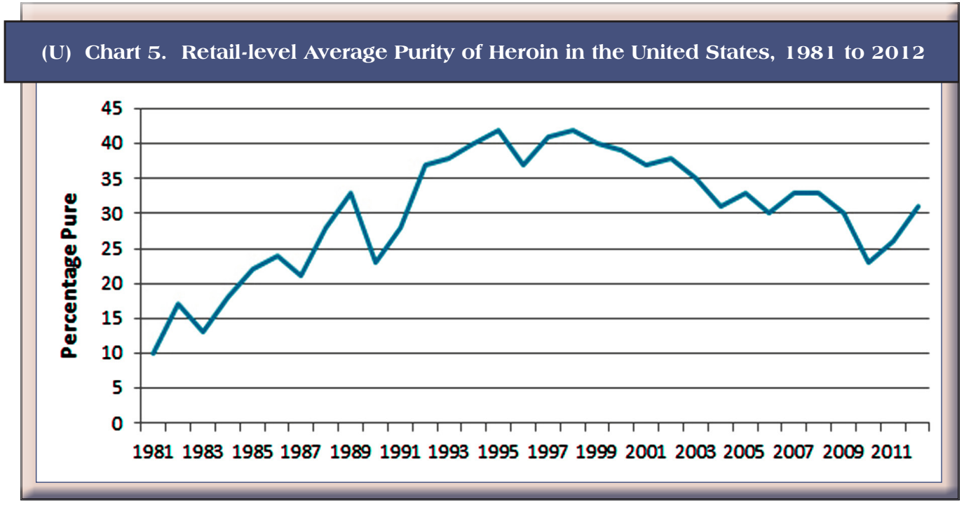
Heroin purity nationally (source DEA)
Retail-level Average Purity of Heroin in the United States, 1981 to 2012
Notes:
National Heroin Threat Assessment Summary DEA-DCT-DIR-039-15 APRIL 2015
http://www.dea.gov/divisions/hq/2015/hq052215_National_Heroin_Threat_Assessment_Summary.pdf

Slide 27
The safest heroin is pure heroin
Uncertain heroin purity is a HUGE problem because it makes it impossible to measure your dose accurately. But the safest heroin is 100% pharmaceutically pure heroin because then you can measure your dose accurately. There have been zero fatalities at the Swiss heroin maintenance treatment program which uses 100% pure heroin.

Slide 28
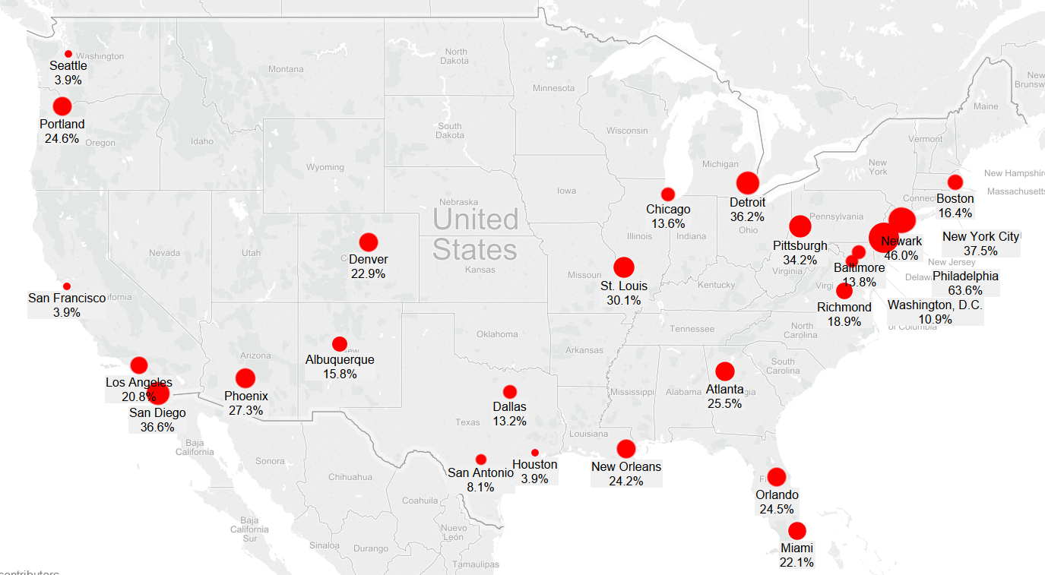
Heroin purity in 2011 ranged from a low of 3.9% in Seattle, San Francisco, and Houston to a high of 63.6% in Philadelphia
Notes:
2011 Heroin Domestic Monitor Program
https://info.publicintelligence.net/DEA-HeroinDMP-2011.pdf

Slide 29
Two Hypotheses
Prescription Opioid involved deaths are up because of people using much larger doses than before whether they mix or not
Heroin involved deaths are up because of inexperienced users switching from Prescription Opioids to Heroin who are unaware of the difference in Therapeutic Index

Slide 30
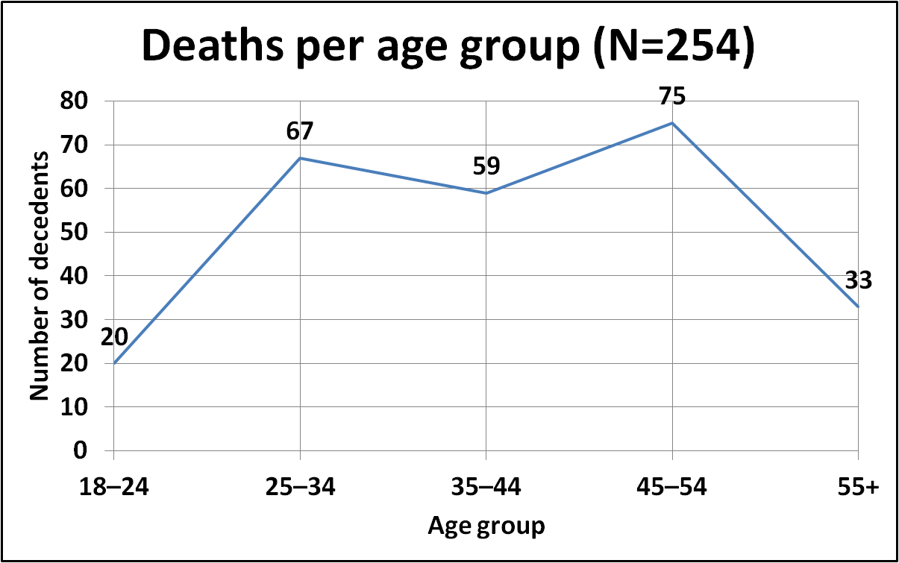
Utah study (Oct 2008 – Oct 2009)
Notes:
Johnson, E. M., Lanier, W. A., Merrill, R. M., Crook, J., Porucznik, C. A., Rolfs, R. T., & Sauer, B. (2013). Unintentional prescription opioid-related overdose deaths: description of decedents by next of kin or best contact, Utah, 2008–2009. Journal of general internal medicine, 28(4), 522-529.
http://www.ncbi.nlm.nih.gov/pmc/articles/PMC3599020/

Slide 31
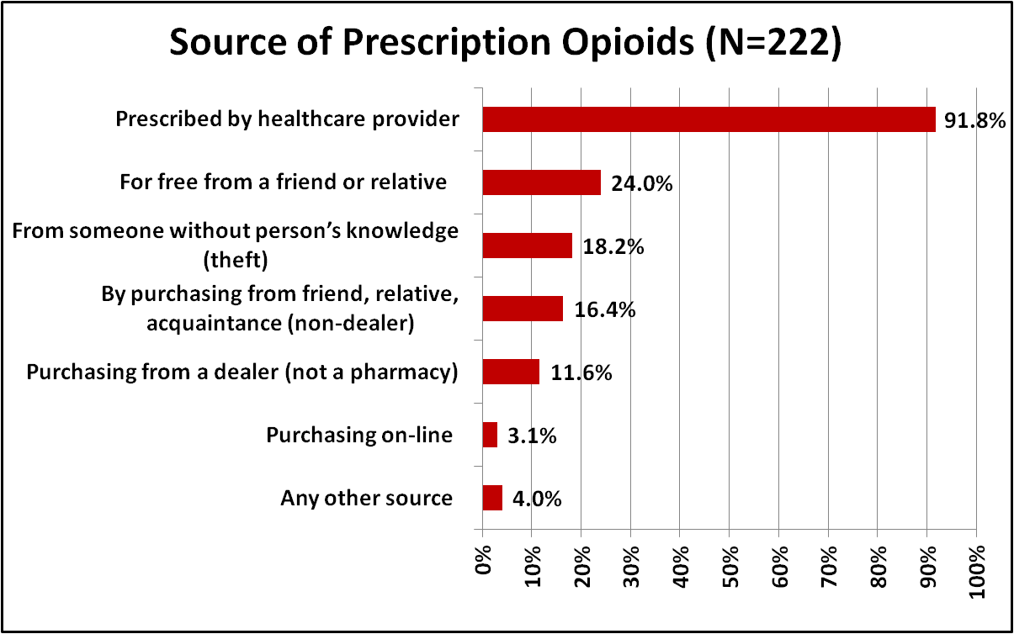
Utah Study
Notes:
Johnson, E. M., Lanier, W. A., Merrill, R. M., Crook, J., Porucznik, C. A., Rolfs, R. T., & Sauer, B. (2013). Unintentional prescription opioid-related overdose deaths: description of decedents by next of kin or best contact, Utah, 2008–2009. Journal of general internal medicine, 28(4), 522-529.
http://www.ncbi.nlm.nih.gov/pmc/articles/PMC3599020/

Slide 32
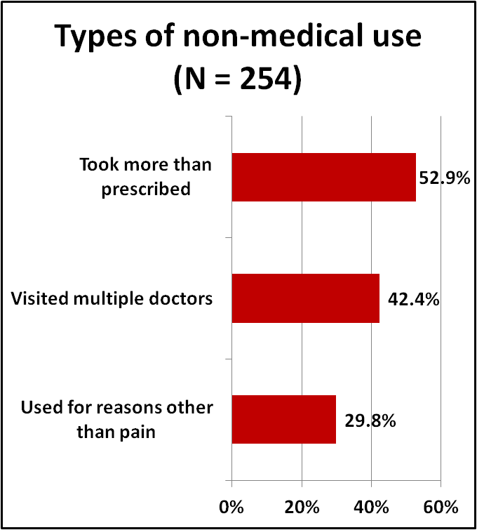
Utah study
Notes:
Johnson, E. M., Lanier, W. A., Merrill, R. M., Crook, J., Porucznik, C. A., Rolfs, R. T., & Sauer, B. (2013). Unintentional prescription opioid-related overdose deaths: description of decedents by next of kin or best contact, Utah, 2008–2009. Journal of general internal medicine, 28(4), 522-529.
http://www.ncbi.nlm.nih.gov/pmc/articles/PMC3599020/

Slide 33
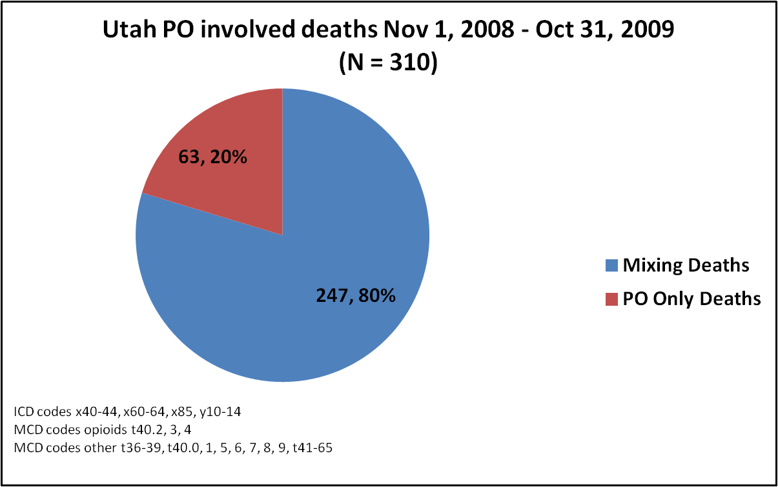
Utah PO involved deaths Nov 1, 2008 – Oct 31, 2009
Notes:
CDC WONDER http://wonder.cdc.gov/mcd-icd10.html

Slide 34
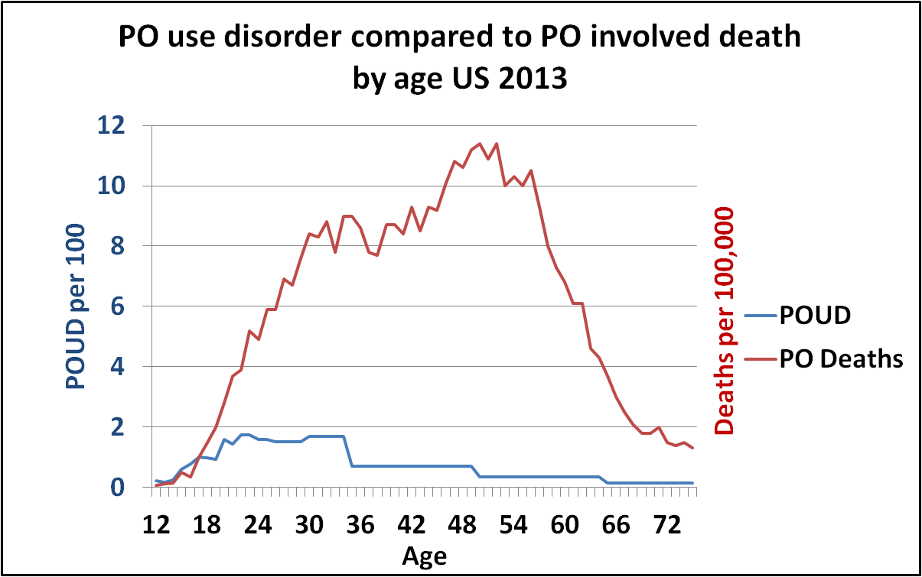
There is NOT a simple correlation between PO use disorder and PO involved death by age
Notes:
CDC WONDER http://wonder.cdc.gov/mcd-icd10.html
NSDUH http://www.icpsr.umich.edu/icpsrweb/ICPSR/series/64

Slide 35
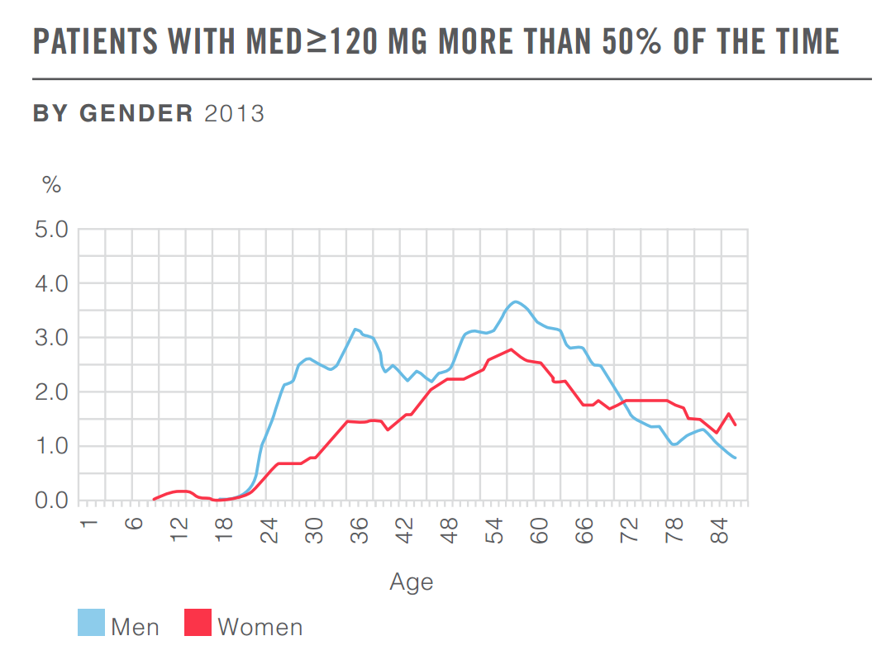
High octane opioid prescribing
Notes:
A Nation in Pain http://lab.express-scripts.com/publications/a-nation-in-pain

Slide 36
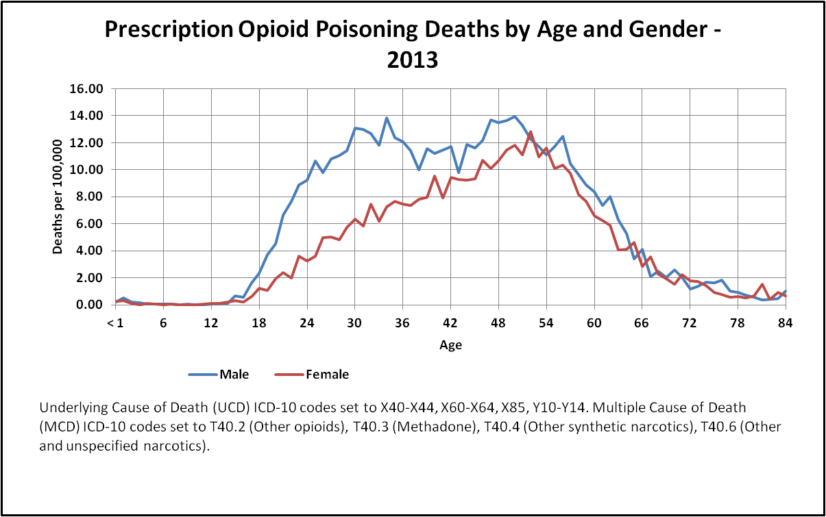
Corresponds almost exactly with high death rates
Notes:
CDC WONDER http://wonder.cdc.gov/mcd-icd10.html

Slide 37
UCD codes x40-44 (accidental), x60-64 (suicide), x85 (homicide), y10-14 (unknown)
Notes:
CDC WONDER http://wonder.cdc.gov/mcd-icd10.html

Slide 38
UCD codes x40-44 (accidental), x60-64 (suicide), x85 (homicide), y10-14 (unknown)
Notes:
CDC WONDER http://wonder.cdc.gov/mcd-icd10.html

Slide 39
How to prevent polydrug poisoning
We need a comprehensive drug poisoning prevention program
We need to start removing the word "overdose" from our vocabulary
We need a media blitz to talk about polydrug poisoning
Naloxone—works even with opioid cocktails
Safe use education for young and non urban folks

Slide 40
Continued
Teach about synergy
Education about reduced tolerance
Maintenance!
Not just methadone, but maintenance with heroin, oxycontin, etc., too
Accurate information in the press and schools
Better prescribing practices

Slide 41
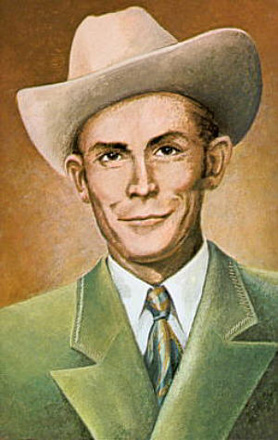
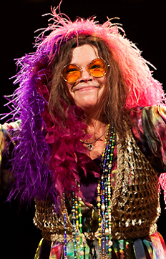
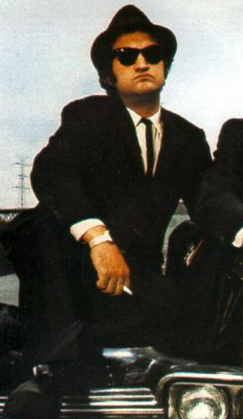
Famous Drug Mixing Deaths
Hank Williams
Alcohol
Morphine
Chloral hydrate
Janis Joplin
Heroin
Alcohol
John Belushi
Heroin
Cocaine

Slide 42
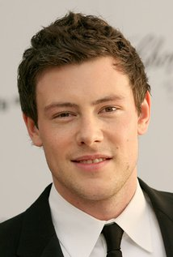
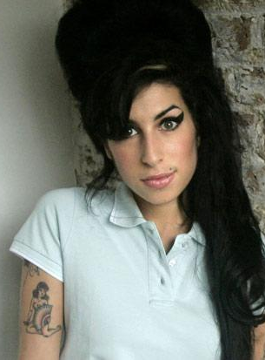
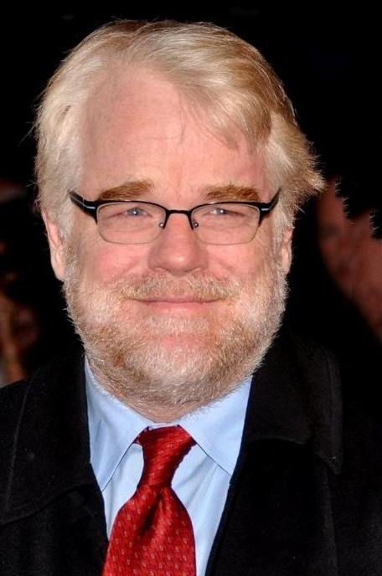
Philip Seymour Hoffman
Heroin
Cocaine
Benzos
Amphetamine
Cory Monteith
Heroin
Alcohol
Codeine
Amy Winehouse
Alcohol
Librium

Slide 43

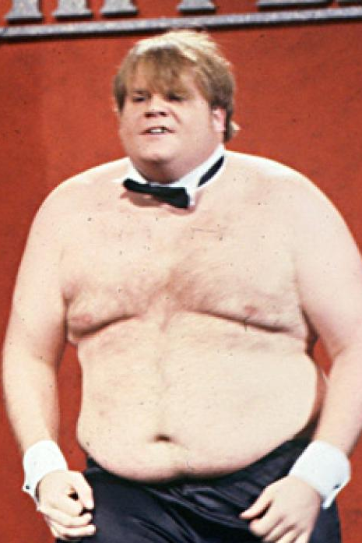
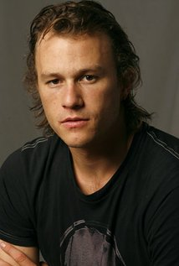
River Phoenix
Heroin
Cocaine
Benzos
Heath Ledger
Prescription opioids
Benzos
Chris Farley
Morphine
Cocaine

Slide 44
RIP
If you are concerned about drug mixing:
Join our facebook drug mixing group
www.facebook.com/groups/drugmixing
Visit our web page
http://drugmixing.org

